Slide 1

Body Sensor Network Lab Project Presentation
Beike Lu, Daoping Wang
Supervisor: Swaminathan Narayanaswamy
Chair of Realtime-Computersystem
Munich, 08.02.18

Slide 2
Outline
Concept design in Matlab - Data analysis - Model design
Model building in Tensorflow - Neural Network classifier
Recognized activities
Android-App development - Backend: Matlab functions re-implemented, manually - Integration of the Tensorflow-model - Graphical User Interface (GUI)
Additional Features - Step counting - State stabilisation
Conclusion - Pros and Cons of our approach - Future work - Project schedule

Slide 3
Concept design in Matlab – Data analysis
Mission: motion reorganization based on sequences of triaxial acceleration data
Idea: Extract feature values from data sequence and predict motion status
Approach: train a classification model using labeled data
x
Feature extraction
Classification
model
y
Feature Vector
Motion prediction
z
Notes:
- Recognize detect using acceleration data captured

Slide 4
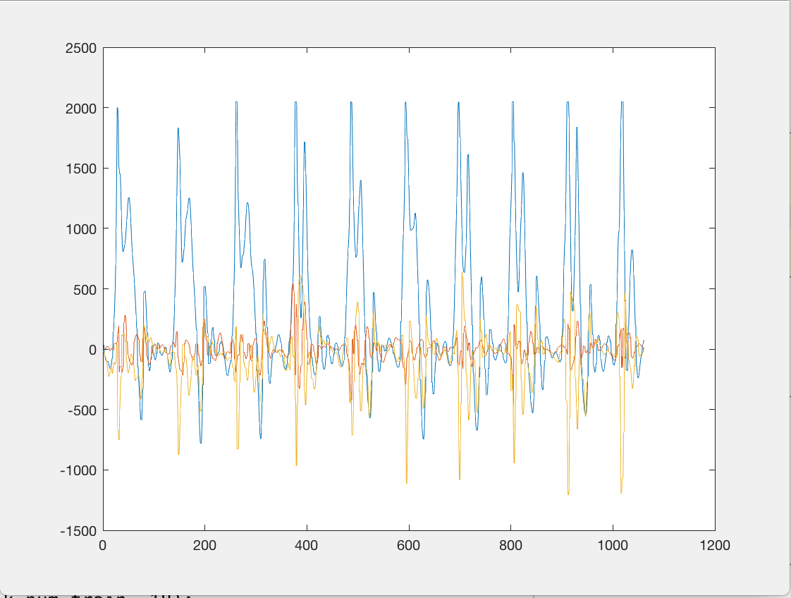
Concept design in Matlab – Data analysis
Step 1: Collect enough training data

Slide 5
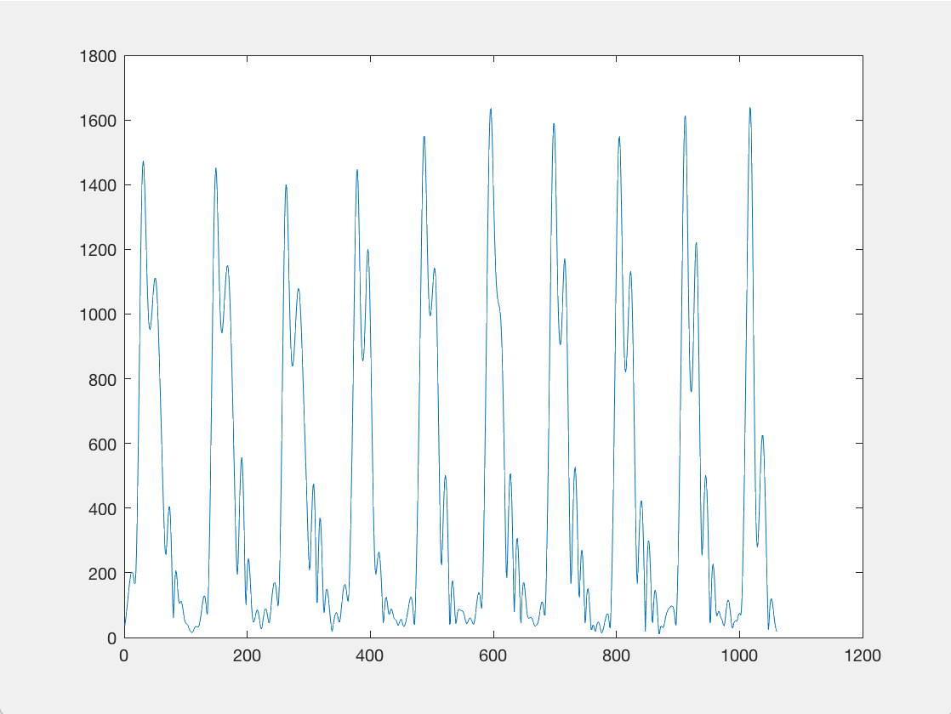
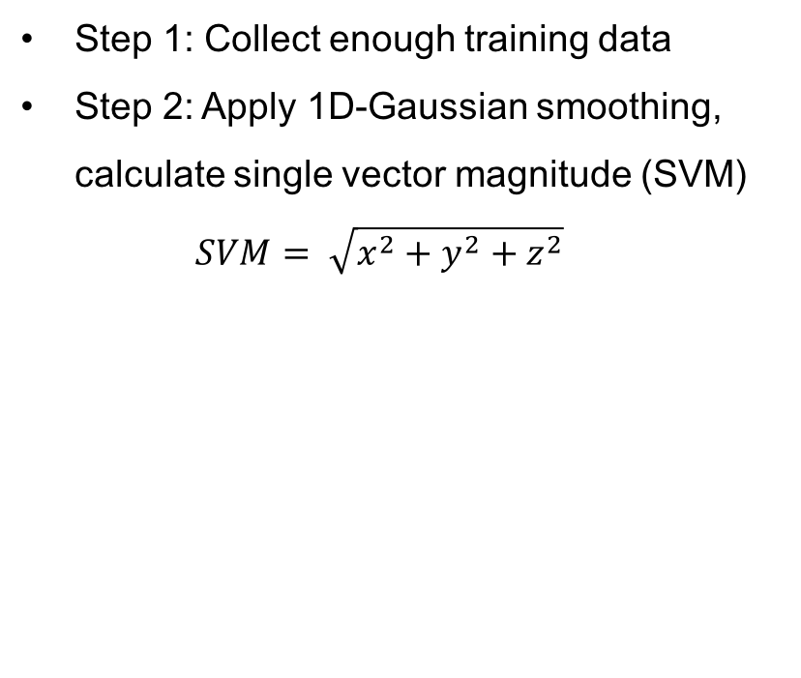
Concept design in Matlab – Data analysis
Step 1: Collect enough training data
Step 2: Apply 1D-Gaussian smoothing, calculate single vector magnitude (SVM) $SVM= \sqrt{x^{2}+y^{2}+z^{2}}$
Notes:
-

Slide 6
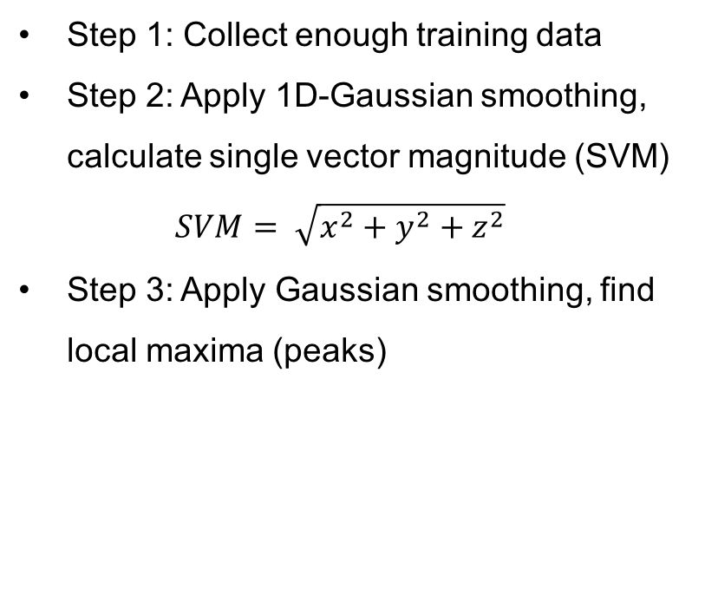
Concept design in Matlab – Data analysis
Step 1: Collect enough training data
Step 2: Apply 1D-Gaussian smoothing, calculate single vector magnitude (SVM) $SVM= \sqrt{x^{2}+y^{2}+z^{2}}$
Step 3: Apply Gaussian smoothing, find local maxima (peaks)

Slide 7
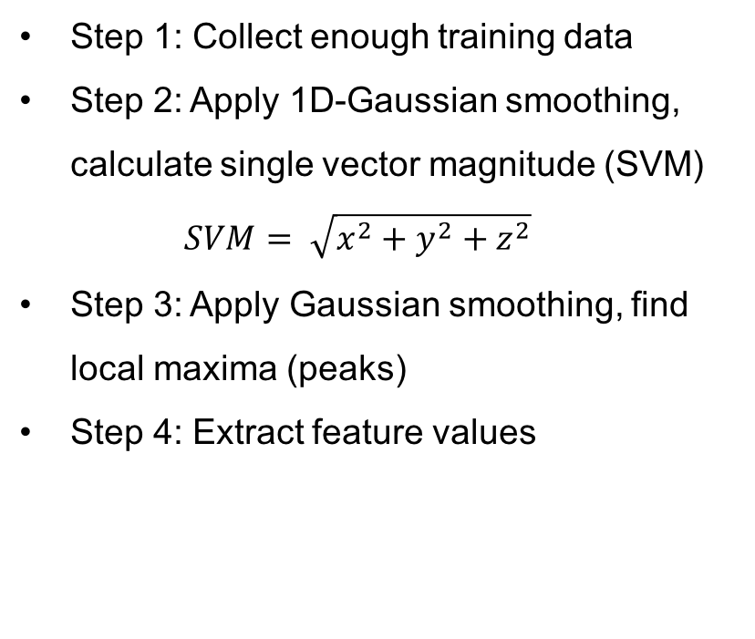
Concept design in Matlab – Data analysis
Step 1: Collect enough training data
Step 2: Apply 1D-Gaussian smoothing, calculate single vector magnitude (SVM) $SVM= \sqrt{x^{2}+y^{2}+z^{2}}$
Step 3: Apply Gaussian smoothing, find local maxima (peaks)
Step 4: Extract feature values
mean(SVM) | 451.702809
mean(x) | 334.6011986
mean(y) | 1.479196048
mean(z) | -88.33209837
max(SVM) | 1443.532031
max(x) | 1571.479894
max(y) | 264.4306325
max(z) | 415.8009428
min(SVM) | 23.47689762
min(x) | -467.3235691
min(y) | -172.2181659
min(z) | -618.6605361
std(SVM) | 422.1894499
std(x) | 525.8459514
std(y) | 51.88509981
std(z) | 137.2740349
mean(Peaks) | 1313.458669

Slide 8
Concept design in Matlab – Data analysis
Feature vector represents the corresponding time series of motion data
The length of the time series can be arbitrary
Our approach: 1. Split training data into short sequences 2. Evaluate feature vectors 3. Train the model
mean(SVM) | 451.702809
mean(x) | 334.6011986
mean(y) | 1.479196048
mean(z) | -88.33209837
max(SVM) | 1443.532031
max(x) | 1571.479894
max(y) | 264.4306325
max(z) | 415.8009428
min(SVM) | 23.47689762
min(x) | -467.3235691
min(y) | -172.2181659
min(z) | -618.6605361
std(SVM) | 422.1894499
std(x) | 525.8459514
std(y) | 51.88509981
std(z) | 137.2740349
mean(Peaks) | 1313.458669

Slide 9

Concept design in Matlab – Model design
Former plan: - Train a decision tree using MATLAB Statistics and Machine Learning Toolbox
Problem: - Good prediction results , but - Loading the trained tree into generated C code: not possible
Plan B: - Train a Neural network using Tensorflow (in Python) (An open-source machine learning framework from Google)
Notes:
.mat file connot be loaded in andrion, decision tree saved special data type→cannot be loaded

Slide 10
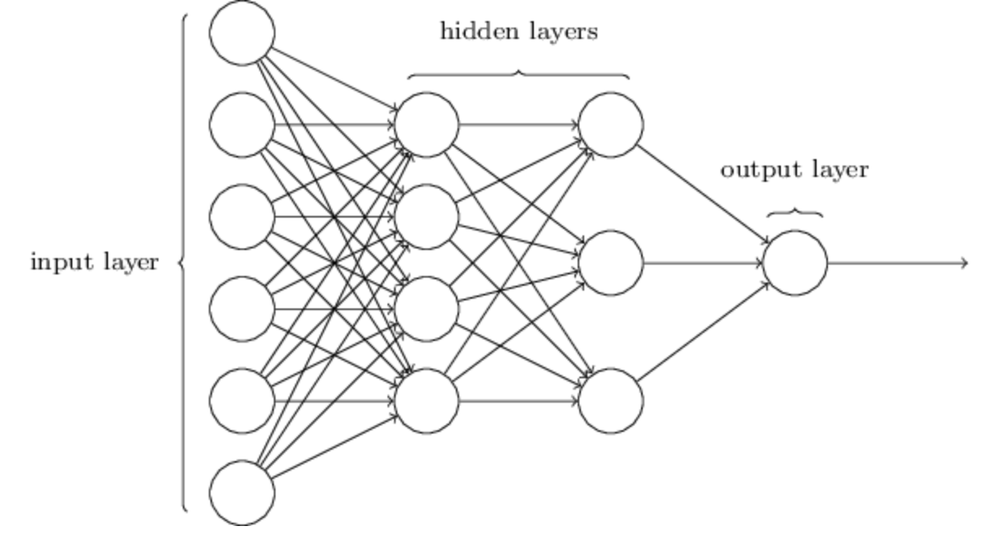
Model building in Tensorflow – Neural Network Classifier
Input layer: 17 neurons (as we have 17 features as input)
Output layer: 4 neurons (4 possible motion states)
Hidden layers: bunch of neurons (to compensate high non-linearity)
Training phase: 1. Using feature vectors of training data as input 2. Let the NN predict motion 3. Optimize the NN using back-propagation
Notes:
-

Slide 11
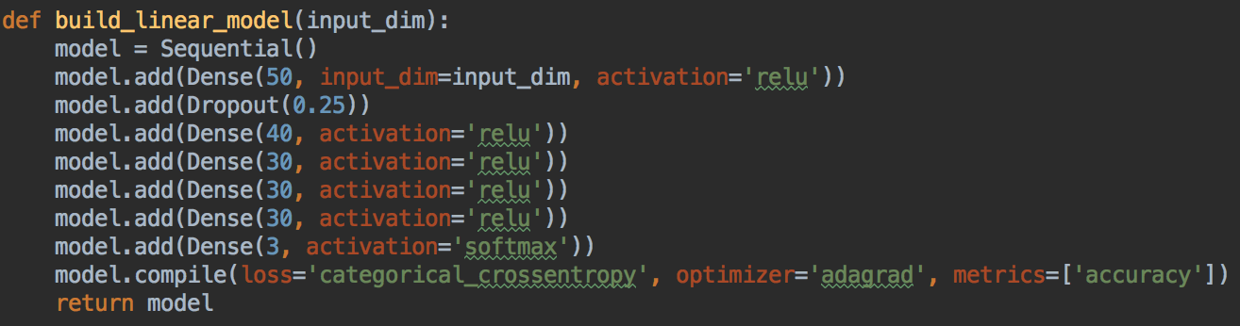
Model building in Tensorflow - Neural Network Classifier
Our model: - 5 hidden layers, each layer consists of ~40 neurons, ReLU as activation function - Dropout rate of 25% between the first two layers (to avoid overfitting problem) - 260 training feature vectors - Results: 99.6% prediction accuracy on training data

Slide 12
Recognized activities
Walking - good recognization accuracy - Step counting possible
Running - the trained model sometimes misjudge jumping for running
Jumping - same as above
Idle

Slide 13
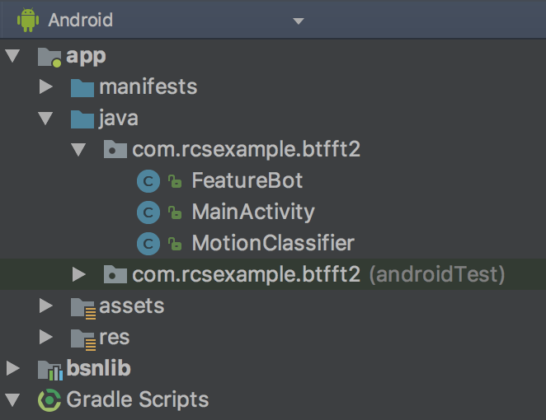
Android App development - Backend
Based on Example-App
Bluetooth connection part untouched
Reimplementation of MATLAB functions for feature extraction
Loading of the Tensorflow model

Slide 14
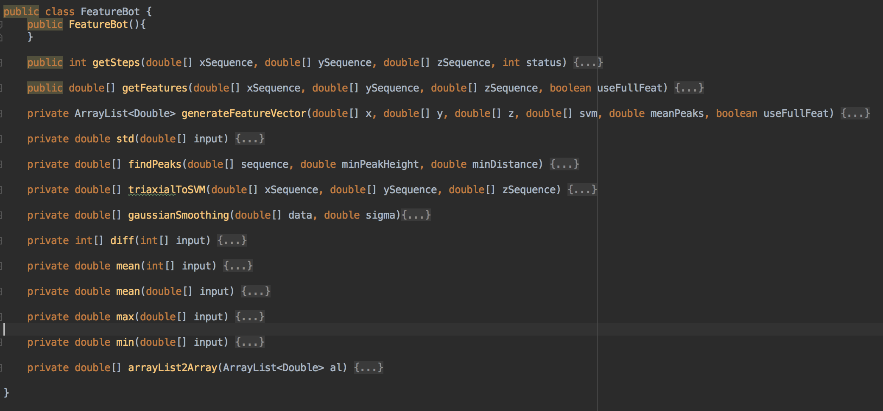
Android App development - Backend - class FeatureBot

Slide 15
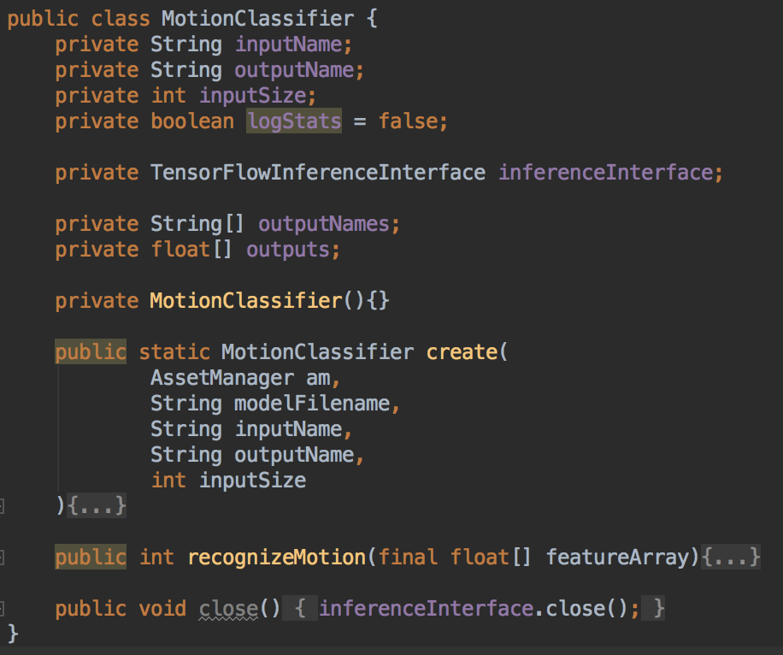
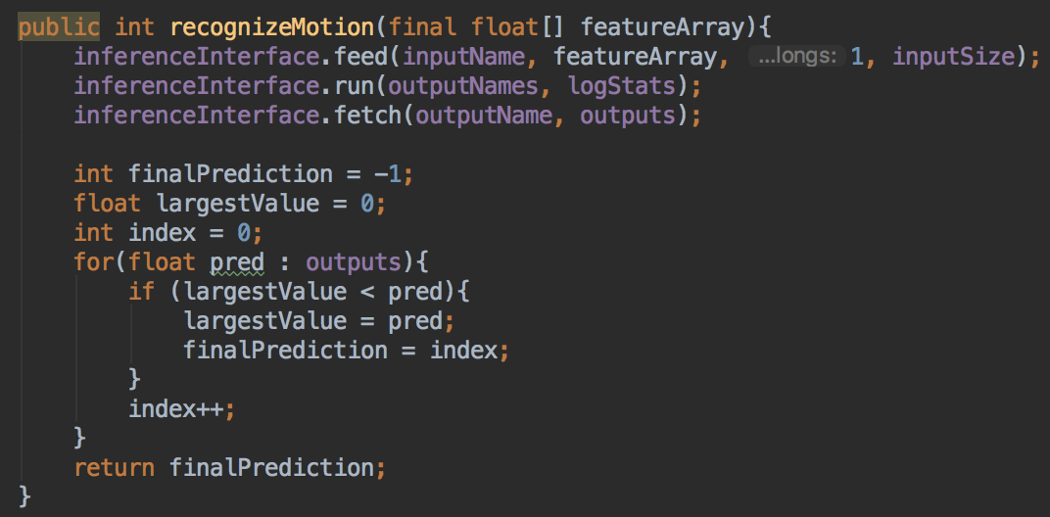
Android App development - Backend - class MotionClassifier

Slide 16
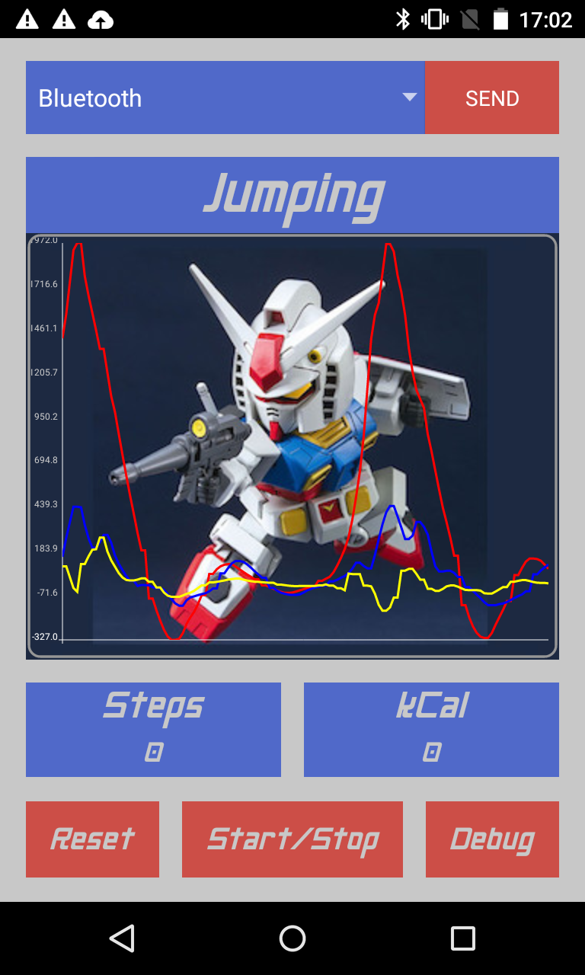
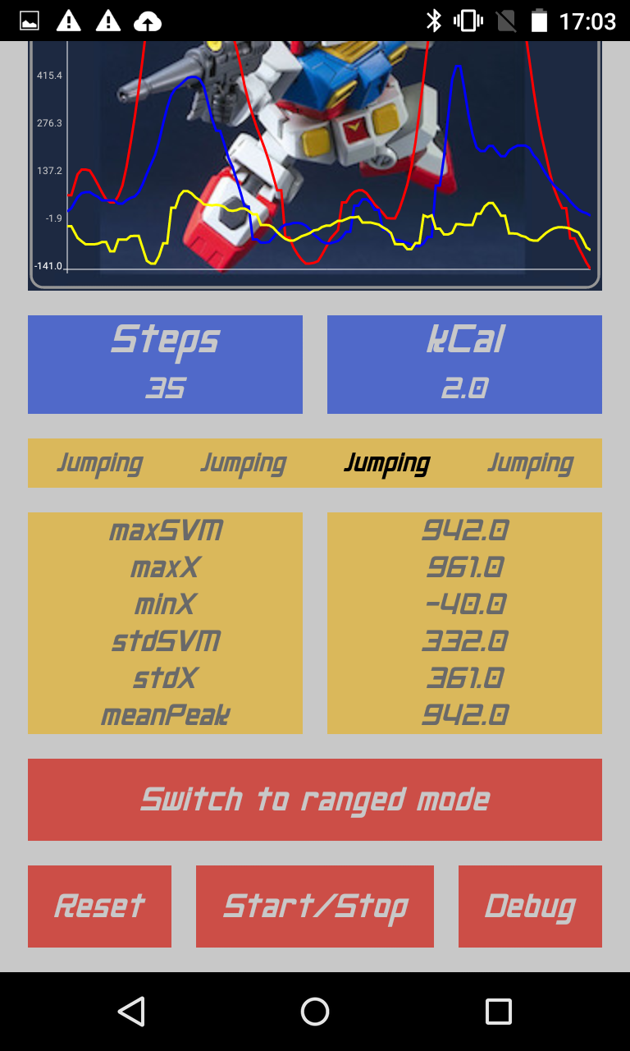
Android App development - GUI
Material Theme
Font: Neo Gen (Gundam style)
Colors: RX-78 grey, RX-78 red, RX-78 yellow
Debug mode: - Last 4 motion states - Most valuable features (contains 78% of the variance in the entire data) - Step counting mode switch
Notes:
So I will go to the GUI design
As you can see, we have

Slide 17
Android App development - GUI
Involved Widgets: - Button - Horizontal / Vertical layout - Relative layout and much more… :)

Slide 18
Additional features – Step counting
Fundamental idea: - Find local maxima (peaks) in data sequence - Use SVM instead of triaxial data
Tunable parameters: - Minimum distance between peaks - Minimum peak height - Level of Gaussian smoothing - Length of the data sequence
Notes:
Single vector magnitude (SVM)
Now I will talk about the additional feature that we implemented
The step counting, the fundamn
This tunable parameter effect most the result
Which

Slide 19
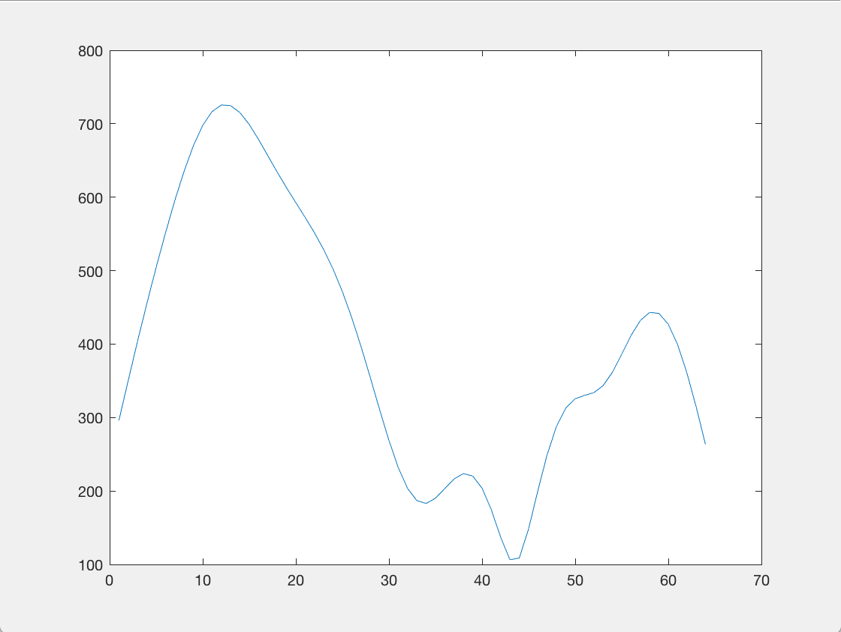
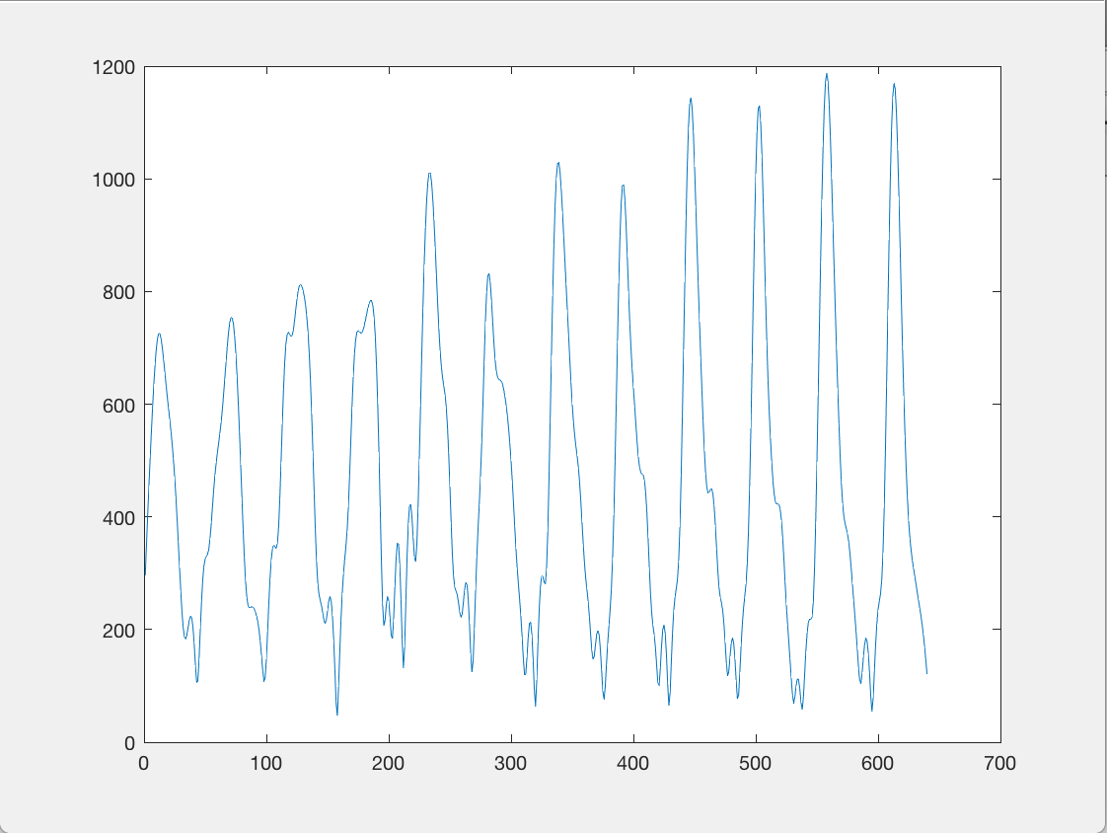
Additional features – Step counting
Length of the data sequence
64 data points (=0.4s) 640 data points (=4s)
Invalid peak
Notes:
About the data sequence, here is a example, on the left is a data sequence of 0.8 s
As for the algorithm the local maximum was found
But this brings to a problem, which is

Slide 20
Additional features – Step counting
Length of the data sequence
64 data points (=0.4s) 640 data points (=4s)
Two peaks instead of one
Notes:
If the two data sequeces are located lke this, the two window of the data sequence will detect the same peak which result unaccuracy
What can we to agoinst that

Slide 21
Additional features – Step counting
Solution: two different counting modes - Real-Time mode (consider the current 0.8s window of sensor data) - Start-Stop mode (Buffer the data until stop, then consider the whole window)
Notes:
We create two differnet counting modes
The first is the real time mode, which only consider the current sequence data

Slide 22
Additional features – State stabilisation
Error correction based on the latest 4 activities
Example: - „Jump“ „Jump“ „Walk“ „Jump“ - The „Walk“ state could be a potential error - Our model will correct it
The activity displayed on top of the App is the previous state
Notes:
The correction of the error can is designed based on the latest 4 activities
For example you can see here are 4 data sequences, and each data sequence is based a 0,8s window, which is showed at the previous slide
If the window (red) displays jump…..,the walk would be a errow
But why are we doing this?
It is because in the reality, it is normal to keep a movement for at least 2 or 3 sencond

Slide 23
Conclusion – Pros and Cons
Pros: - NN Classifier has a very high prediction accuracy - The model is trained offline on PC → Low performance cost on mobile phone - Easy to expand detected activity types - Relatively robust against noise
Cons: - High demand on data collection - The model cannot distinguish sitting from standing - If activity transition occurs within the same window → Model gets confused
Notes:
- colect correspinding data, add output neuron, let the neuron train
The training data contains noise, collected data are from different people, so it is very nosiy, but good prediction, app
Traning large nuron data,, high nonlinearity, need a lot of training model
Position of the sensor chest posistion
Angel end position must be the same
Jumping running within 0.8 second
We need a high amount of data to train, so we need a lot of data

Slide 24
Conclusion – Future work
Better GUI
Try other sensor wearing positions (e.g. inside a pocket etc.)

Slide 25
Conclusion – Project schedule

Slide 26
Thank You

Slide 27
Your Contact Person
Beike Lu
Project Manager
lubeike93@gmail.com
Mobil: 0162/1032097

